Slide 1
NUMBER PLATE DETECTION NEAR PARKING
201FA04147– G.DURGA SUSMITHA
201FA04140– B.DEEPTHI
211LA04172 – V.LAVANYA

Slide 2
Index
Introduction
Problem statement
Scope
Steps followed to extract number plate from image
Result
Future scope
Conclusion
References

Slide 3
Introduction
Number plate recognition is realized by acquiring images of either the front or the rear of vehicles with cameras and then by image processing to identify license plates.
It consist of three main stages.
First one is Number Plate Identification & Localization in this segment the visual of the scene is improved by image processing.
Second is Character Segmentation in which characters segmented from the detected number plate for retaining the useful information to the system so that further processing can take place.
Third is OCR Optical Character Recognition in which text is transferred into encoded text information.

Slide 4
Problem Statement
Automatic Number Plate Recognition System is the identification system of vehicles.
It is an image processing technology used to identify the vehicles only by their license plates.
Automatic Number Plate Recognition ANPR plays an major role in management of parking areas, and surveillance of illegally parked vehicles.
Since every vehicle has a unique number plate so it can be identified by its number plate.
The classification is utilized for the display available parking spaces to vehicles.
The identification is also employed for managing parking facilities, monitoring and analysis of traveling time, and security systems such as observation of stolen vehicles and monitoring of unauthorized vehicles entering private areas

Slide 5
Scope
The aim of the Automatic Number plate recognition (ANPR) is record keeping , as record keeping is the very difficult job to do manually.
In this system our most focus is on reducing the manual work in opening and closing of gate.
The main goal of this work is to design and implement efficient and novel architectures for automatic number plate recognition (ANPR) system, which operates in high definition (HD) and in real time.
In addition, a separate ANPR algorithm is developed and optimized, by taking advantage of technical features of digital image processing algorithms.

Slide 6
Steps Following in Number Plate Detection
Importing Libraries We need .
Resizing the image
Converting Our image from RGB to Gray Scale
Reducing Noise From our Image
Detecting the edges of the images
Finding Contours of the image
Sorting the contours
Extracting Text From image

Slide 7
1. Importing Libraries
OpenCV
imutils
pytesseract

Slide 8
2. Resizing the image
Resizing an image is a good practice, it helps with processing the image better and also helps the machine train on smaller images faster.
We can resize the image file by a factor of 2x in both the horizontal and vertical directions with the help of resize.

Slide 9
3. Converting Our image from RGB to Gray Scale
Now before detecting the number plate we would need to do some image processing so that detection becomes easy.
First of all, we would convert our image from RGB to Grayscale We can Complete this task by making use of method in opencv called cvtColor() method.
When we convert a RGB image into Gray scale you discard lots of information which are not required for processing.
The main reason for converting RGB to grayscale is to remove color redundancy and obtain a compact and optimal image representation.

Slide 10
4. Reducing Noise From our Image
By removing information that we don’t need, data that is noise from our perspective, this technology makes tasks faster and easier.
Noise removal is an important task in image processing.
In general the results of the noise removal have a strong influence on the quality of the image processing techniques.
Apply a Bilateral filter over it in order to reduce image noise.
A bilateral filter is a non-linear, edge-preserving, and noise-reducing smoothing filter or images.
It replaces the intensity of each pixel with a weighted average of intensity values from nearby pixels. This weight can be based on a Gaussian distribution.

Slide 11
5. Detecting the edges of the images
By using cv2.Canny(image, lower, upper) we would detect the edges of the objects in the images.
Edges help us in separating objects from another, and computers would like to do the same.
With the help of the following code, the computer would be able to determine object boundaries and thus separate the object of interest.
The Canny edge detector is an edge detection operator that uses a multi-stage algorithm to detect a wide range of edges in images.
the Canny algorithm uses four filters to detect horizontal, vertical and diagonal edges in the blurred image.

Slide 12
6. Finding Contours of the image
Recognize an object. You can find the contours of various shapes, objects in an image using the findContours () method.
This method accepts the following parameters A binary image.
We will be using cv2.findContours(image name, cv2.retr_list, cv2.chain_approx_simple) to do so.
Contours are basically the curves that join all the continuous points having the same intensity or color,cv2.findContours(image name, cv2.retr_list, cv2.chain_approx_simple) join all the points along the boundary of an object, therefore using the image with edges detected is better.

Slide 13
7. Sorting the contours
All Contours include very small and insignificant ones as well so we would want to get rid of those and would want only the major contours.
So we would loop over all the contours, and find out which contour is fit to be a license plate.
we would like to find the contour that is rectangular in shape, and we would be using the function cv2.approxPolyDP(current contour, maximum distance from contour to approximated contour, True) for this, which will approximate a polygon (in our case, a rectangle).

Slide 14
8. Extracting Text From image
We can use pytesseract to extract the license number from the number plate.
Pytesseract is an optical character recognition (OCR) tool for python. It helps in recognizing the text and digits in an image.
We first do some image-preprocessing and then we use pytesseract to extract the text from the image.
It can read all image types supported by the Pillow and Leptonica imaging libraries, including jpeg, png, gif, bmp, tiff, and others.

Slide 15
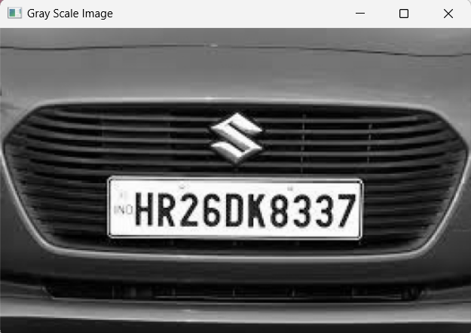
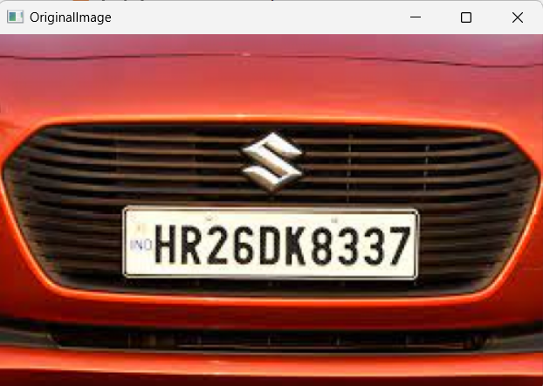
Result
Gray Scale Image
Original Image

Slide 16
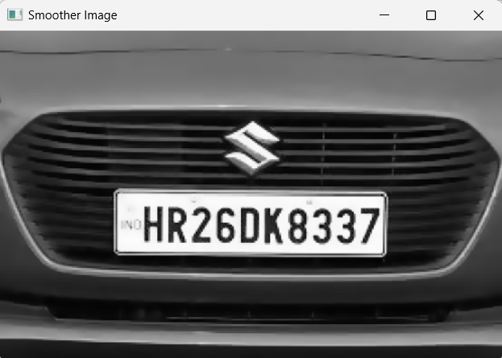
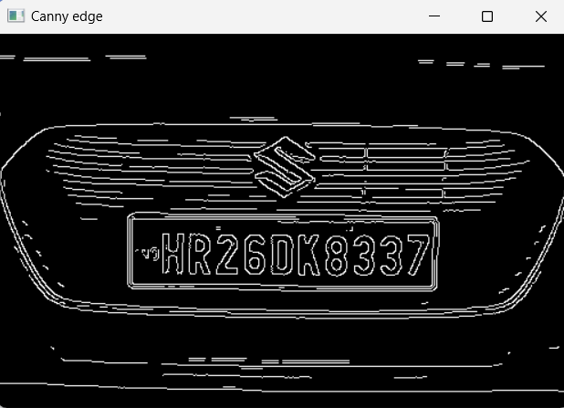
Result
Smoother Image
Canny Edge

Slide 17
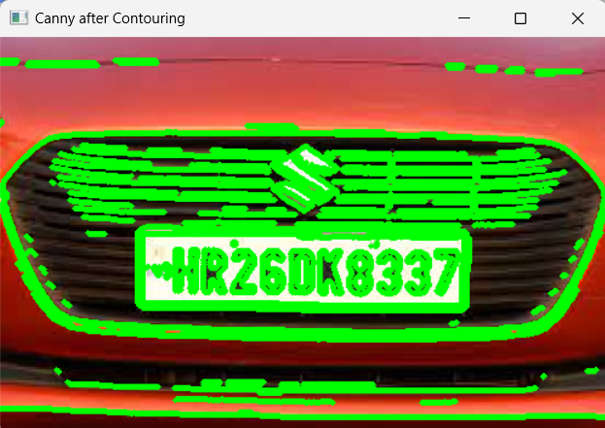
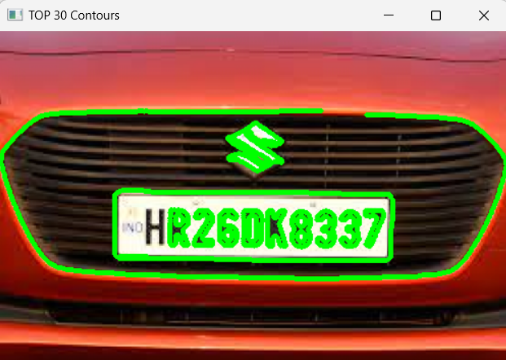
Result
Canny after Contouring
TOP 30 Contours

Slide 18
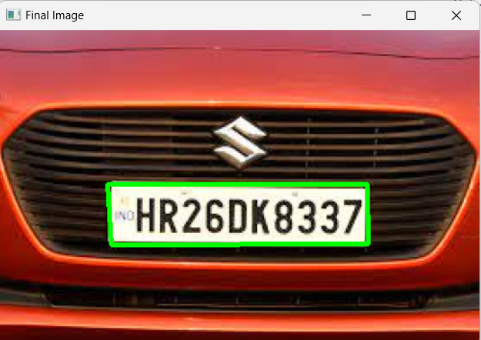
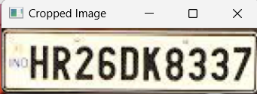

Result
Final Image
Cropped Image
Text From Image

Slide 19
Future scope
In future, Image capturing system will install. Camera will place on door, when car will arrive camera capture picture of front of car then localize the number plate and do further recognition process.
If number plate is authorized then door will open otherwise an alarm will ring.
Aside from residential communities, ANPR has also been used in facilities that need to protect confidential information.
In these high-security properties, access is restricted to staff only to reduce theft of intellectual property.

Slide 20
Conclusion
In ANPR System , A image will be taken and will be preprocessed first to reduce the noise present in that image converting RGB image into Gray Scale image which will be further converted to smoother image by reducing noise and will be finding edges and contours .
By sorting the top 30 Contours identified we are finding the region of number plate and will be extracting text from the vehicle number plate .

Slide 21
References
https://ieeexplore.ieee.org/document/8748287
https://viso.ai/computer-vision/automatic-number-plate-recognition-anpr/
https://www.researchgate.net/publication/332687116_NUMBER_PLATE_RECOGNITION_ SYSTEM
https://ieeexplore.ieee.org/document/7831610

Slide 22


